Slide 1

Analysis of Hardware Components
Group-7
Amandeep Kaur(748434)
Shweta (747925)
Ronakkumar Sharma(747019)

Slide 2
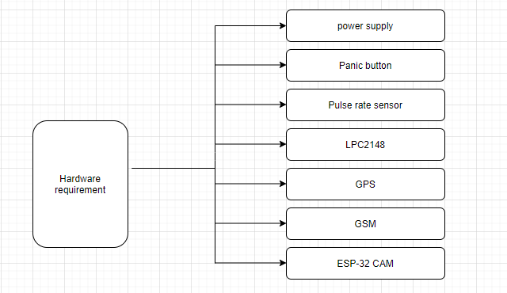
Hardware Requirement

Slide 3
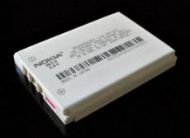
Lithium Ion battery
Easily rechargeable
Low weight
Long lifespan
Power management
Low maintenance

Slide 4
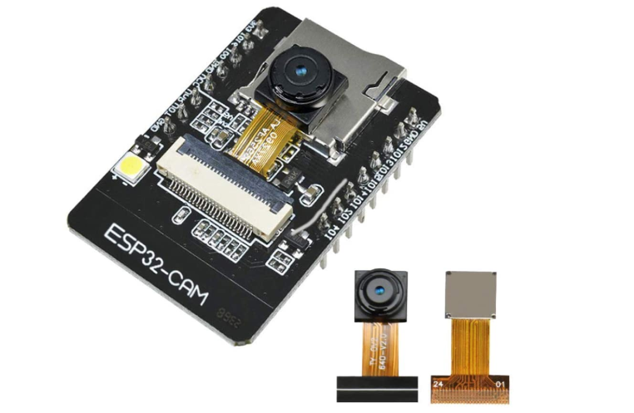
ESP-32 CAM
Specifications:
Smart small camera which is considerable for
IOT applications.
32 bit CPU which work on 240Mhz.
Inbuilt 520 Kb SRAM
I2C,SPI,UART,PWM,ADC,DAC are supported
with this module.
Multiple sleep modes.

Slide 5
More suitable for
Best use for Industrial wireless control, smart Home appliances, Surveillance purposes.
Pictures of victim can be taken with this module which will be stored on Cloud.

Slide 6
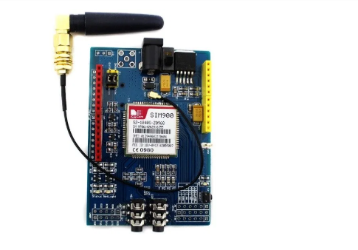
SIM900 GSM module
12 general purpose input /output pins.
Supports UART interfacing.
It can be work as per AT commands.
For calling predefined number,
microphone well as headphone
jack is available.

Slide 7
More suitable for
One can transmit or receive messages.
It is helpful to make phone calls.

Slide 8
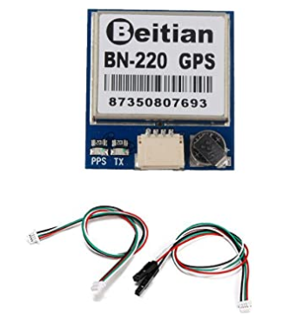
Beitian BN-220 GPS module
Power consumption is between 3V-5V.
Data rate is considered from 4800bps to
9216000bps.
Pins : VCC,TX input, RX output, GND

Slide 9
More suitable for
Trace the location of a person with help of GPS co-ordinates. In the case of emergency GPS co-ordinate are send with alert message to the stored contact numbers.

Slide 10
Reference
Amazon.(2020). ESP32-CAM Camera WiFi + Bluetooth Module 4M PSRAM Dual-core 32-bit CPU Development Board with OV2640 2MP Camera Module Support Image WiFi Upload. https://www.amazon.ca/dp/B07WTBTKDM/ref=pe_3034960_233709270_TE_item
Random NERD tutorial.(2020). SIM 900 GSM module.
https://randomnerdtutorials.com/sim900-gsm-gprs-shield-arduino/

Slide 11
Amazon.(2020). Beitian BN-220 Dual GPS Glonass Module Navigation TTL Level 9600bps + GPS Passive Antenna for Arduino Raspberry Pi Pixhawk F3 CC3D Betaflight F4 Flight Control Geekstory.
https://www.amazon.ca/dp/B07PRDY6DS/ref=pe_3034960_233709270_TE_item
B.H.(2020). LP-E12 Lithium-Ion Battery Pack (7.4V, 800mAh).
https://www.bhphotovideo.com/c/product/908219-REG/watson_b_1537_replacement_battery_pack_for.html
.

